Slide 1
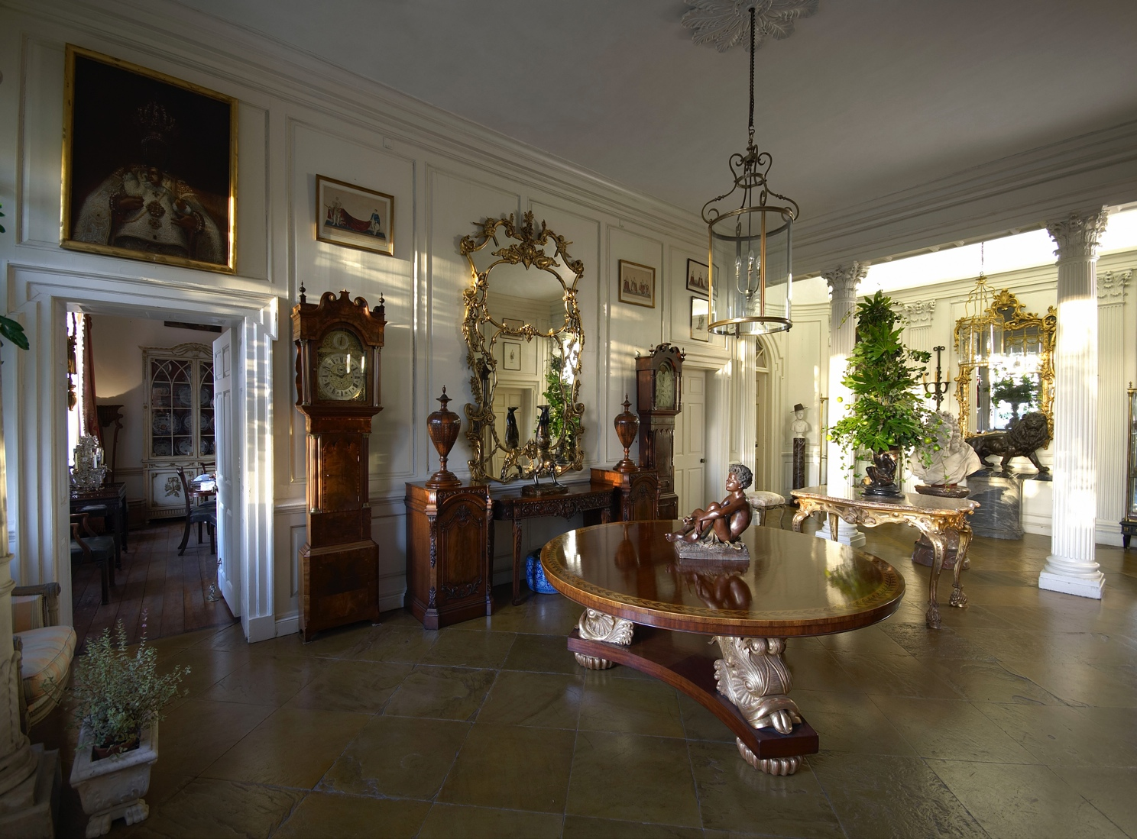
Unlocking the Potential of Hidden Wealth: Managing Tangible Assets
Colleen Boyle, Senior Vice President - Pall Mall Art Advisors

Slide 2
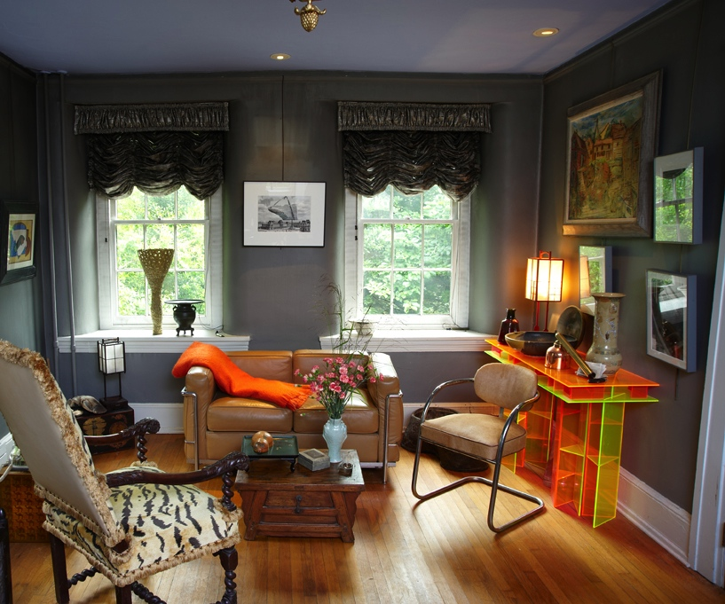
Tangible Asset Management
Anything of value that can be transported
Tangible Assets can be 10- 20% of net worth
Managing tangible assets similar to financial assets
Protecting a client’s legacy
Notes:
^{in}
an increasingly competitive market place, client-centric services around passion assets, on the one hand, offer significant potential in building stronger bonds between the wealth management industry and their clients and, on the other hand, have a fiduciary responsibility to incorporate art and collectibles in their service offering as more and more wealth is allocated to passion assets.

Slide 3
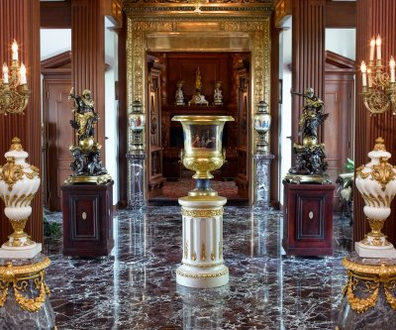
An Asset Class in its own right
Period Furniture
Fine Arts
Decorative Arts
Rugs
Jewelry
Musical Instruments
Books & Manuscripts
Collectables
Wine
Collector Cars
Stamps & Coins
French ormolu mounted Grand Piano
Fair Market Value $253,000

Slide 4
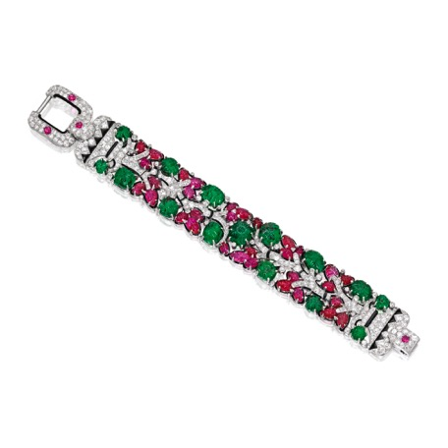
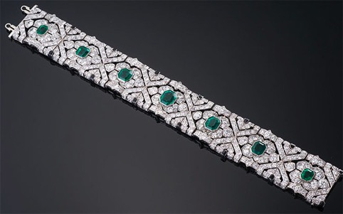
What’s it Worth?
Art Deco Emerald, Diamond
and Black Enamel Bracelet
Sold for $255,000
Platinum, Emerald, Ruby, Diamond and Enamel 'Tutti Frutti' Cartier Bracelet
Sold for $1.63 million

Slide 5
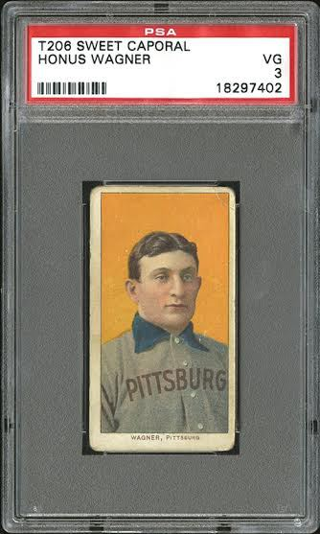
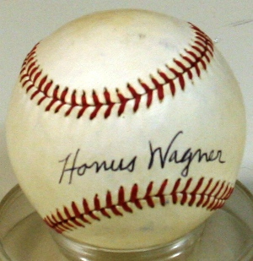
What’s it Worth?
T206 Honus Wagner, 1909
$1.3 million
Honus Wagner signed baseball
$7,500

Slide 6
Options for Tangible Assets
Sell
Donate
Gift

Slide 7
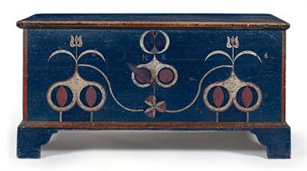
Determining Asset Value: The Foundation of All Decisions
Artist
Medium
Size
Subject matter
Condition
Provenance
Rarity
Sales history
Polychrome & Paint Decorated Blanket Chest
Sold $179,000 at Christies

Slide 8
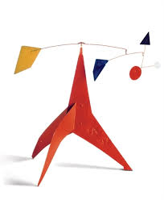
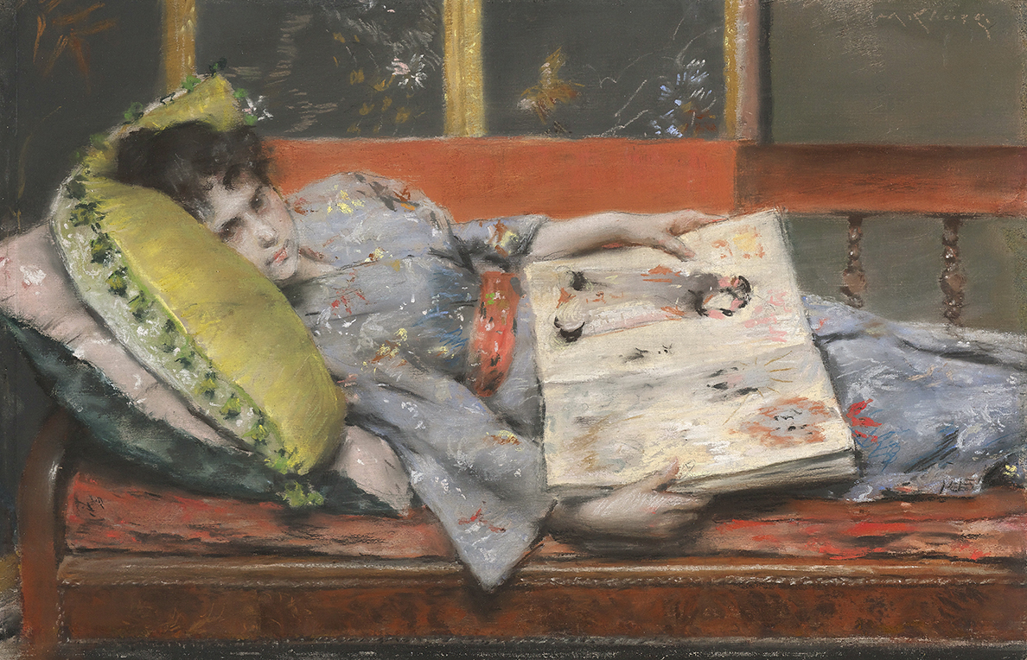
Value Changes
The William Merritt Chase painting was inherited 12 years ago and insured for $13,000.
The actual value of the painting is $980,000
The Alexander Calder sculpture was purchased 16 years ago and insured for $50,000.
The actual value of the Calder is $1.5 million

Slide 9
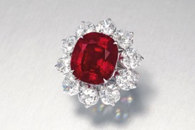
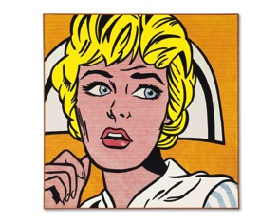
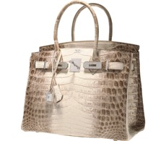
Appreciating Asset Classes
1956 Ferrari 290 MM by Scaglietti
Sold for $28mm
The Crimson Flame Ruby 15.04 Carats
Sold for $18.3mm
Roy Lichtenstein
Nurse, 1964
Sold for $95.4mm
Birken Himalayan Nilo Crocodile
Sold for $185,000

Slide 10
2015 Art Sales Results
The United States once again dominate Global Art Market with 38% market shares
3 works fetched over $140 million each at auction
Contraction of Chinese Market
Pablo Picasso (1881-1973)
Les Femmes d’Alger (Version ‘O’)
44 7/8 x 57 5/8 in.
$179.4 million

Slide 11
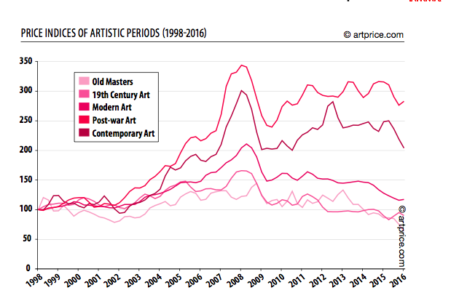
Fine Art Market
Notes:
The return on investment for art exceeds other asset classes but all art does not appreciate at the same rate. 2015 is first time that Chinese Collectors have 14 investors listed on top 200 world collectors. Chinese dominate Global markets for 5 year period until 2015 when US regained this position. Chinese collectors began collections as repatriation of historical property. Now they are diversifying portfolios to include more western art. Post War and contemporary Art defined as artists born after 1910. As of 2016, this sector had the highest recorded level. Modern art sector is classified as artists born between1875 and 1910. Art has historically faired well as an asset class for a number of reasons. 1. Lack of Government interference (Unregulated commodity). Auctioneers are licensed but besides this there are no regulations. 2. Art is an asset of passion and status with media interest. 3. The amount of Global wealth. 4.The internet, with 95% of all auctions online- meet lifestyle of buyers. 5. Financialization of the Art Market 5. The record number of museums built (700 in 2015), each needing “Masterpiece”, creating record prices for new Mona Lisa.

Slide 12
Art Market Contemporary and Modern Sales Outlook
Chinese Art sales dropped 41% in 2015
Indian Art sales increased 13.5%
Southeast Asian Art sales increased 28% in 2015
Latin American art sales increased 11%
Middle Eastern Art sales up 5%
Russian Art sales dropped 68%
African modern and contemporary art markets continue to grow
BENEDICT CHUKWUKADIBIA ENWONWU M.B.E
(Nigerian, 1917-1994)
The gathering of the chiefs, Asaba
Notes:
With international sanctions on Iran lifted, many art market experts believe we could see strong domestic and international growth in the Iranian art market in the next 12 months.
Bonhams organized three dedicated sales to African modern and contemporary art in 2015, up from one annual sale in previous years. Bonhams’ Africa Now auctions raised £1.64 million in 2015, up 53 percent from 2014. Experts have a neutral-to-positive outlook for the next 12 months on the African art market.
Philippine art market set to grow: whilst the majority of the focus has been on
Indonesian artists in recent years, the Philippine art market, with its well-developed
auction market, international art fair, and vibrant local gallery scene, is well positioned
to grow into one of
the leading regional Southeast Asian art markets in the future.

Slide 13
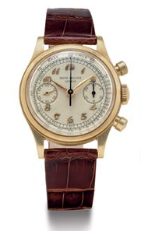
The Gentleman’s Market
PATEK PHILIPPE
18K Gold Wristwatch
Value: $254,000
GOLD-INLAID COLT MODEL
1849 POCKET REVOLVER
Value: $1.1 million
1956 FERRARI 290 MM
By Scaglietti
Sold at RM Sotheby‘s for $28 million

Slide 14
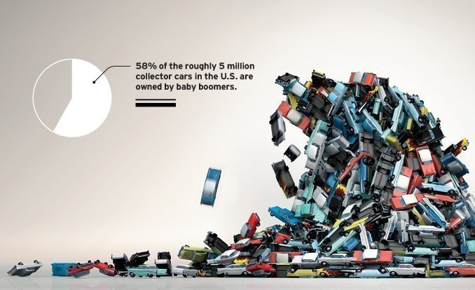
Collector Cars

Slide 15
Cars to Watch
1974 – 1977 Porsche 911
2. 2004 – 2009 Aston Martin DB9
3. 1984 – 1996 Ferrari Testarossa/512 TR/F512 M
4. 1975 – 1985 Ferrari 308 GTS/GTB
5. 1990 – 2001 Lamborghini Diablo

Slide 16
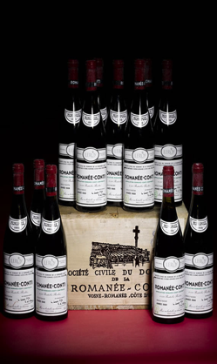
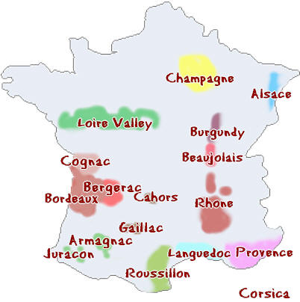
French Wine
Case Romanée-Conti 1990, Value: $297,500

Slide 17
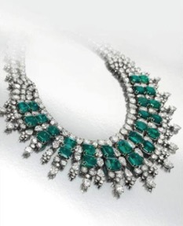
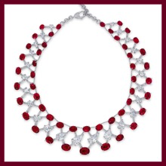
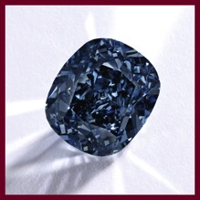
Growth of the Jewelry Market
Harry Winston
Emerald and Diamond Necklace
Value: $1.2 million
Ruby and Diamond
Latticework Necklace,
Sold for $13mm
Each stone was found in famous Burmese mines
The Blue Moon of Josephine
Diamond Ring
13.02 Carats
Sold for $48.4 mm

Slide 18
Fair Market vs. Retail Replacement Value
Estate Planning/Probate Appraisals
Divorce
Equitable Distribution
Donation
Gift Tax
Art as Collateral
Auction Estimates
Frank Bensen, Down the Rapids
Sold at Christies for $86,000

Slide 19
What is Retail Replacement Value?
ALFRED MAURER (AMERICAN/FRENCH 1868-1932)
Sold 2006 at auction for $46,000
Purchased by Hollis Taggart Galleries and sold for $110,000

Slide 20
Blind Spots
Authenticity
Clear Title
Fakes/Forgery
Tax Issues
Roy Lichtenstein (American, 1923-1997)
Sunrise
22 ½ x 36 in.
Paid $43,000 in 1993
Sold for $341,000 in 2014

Slide 21
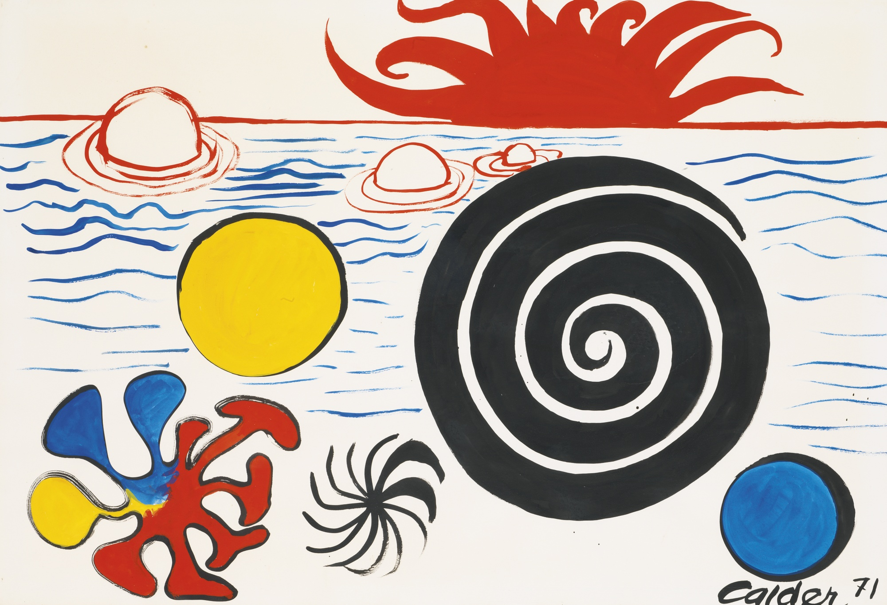
Authenticity
Alexander Calder (American, 1898-1976)
Flat-Footed Octopus
Gouache and ink on paper
Sold $143,750

Slide 22
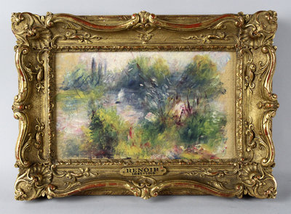
Clear Title
Pierre-Auguste Renoir
On the Shore of the Seine
5 ½ x 9 in.

Slide 23
Forgery & Fakes
Untitled 1950, disputed painting attributed to Jackson Pollock
Sold for $17 million at Knoedler Gallery

Slide 24
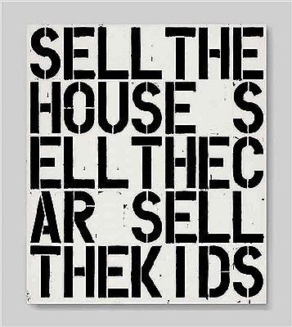
Ensuring an IRS Audit Free Process
The Art Panel and Audit Process
Probate
Charitable donation
1031 exchange
Fractional interest
Gifting
Leasing
Christopher Wool (American, b. 1955)
Apocalypse Now
Sold for $26, 485,000 in 2013

Slide 25
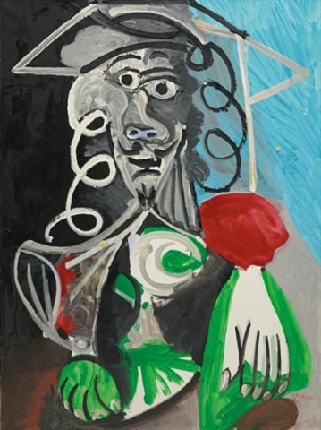
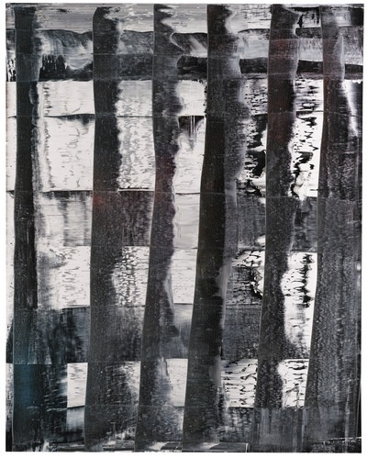
Art as Collateral
Pablo Picasso (Spainish, 1881-1973)
Buste d'homme Painted on September 27, 1969
$10.5 million
Gerhard Richter (German, 1932)
Abstraktes Bild
$7.7 million

Slide 26
Navigating the Murky Art Market: The Designer and Dealer Dilemma

Slide 27
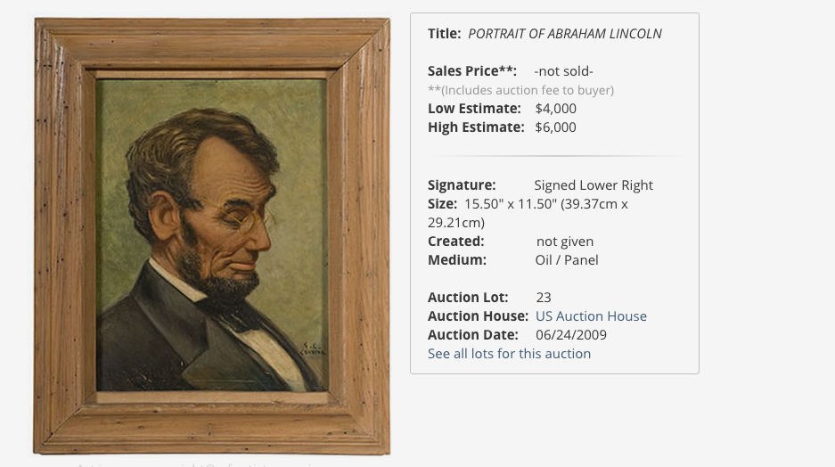

Slide 28
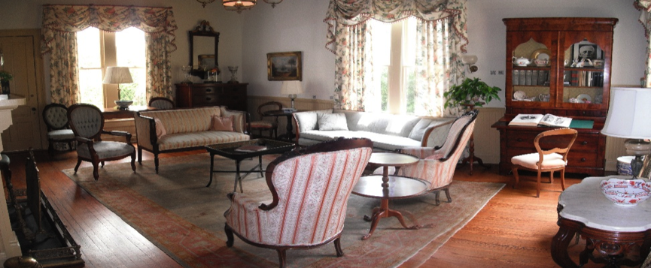
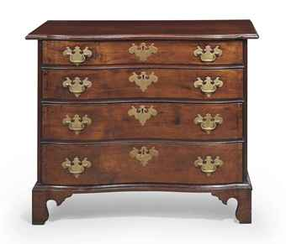
Generational Changes Why the Kids Don’t Want it

Slide 29
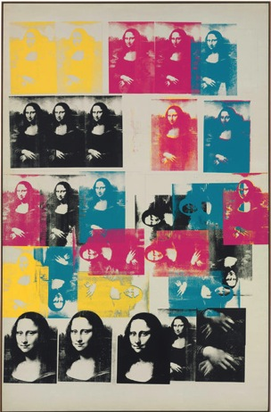
Selling at Auction the Smart Way IT IS ALL NEGOTIABLE
Seller’s commission
From 0 to 25%
Insurance
Storage and Shipping
Catalogue Fee
Photography Fee
Guarantee’s/global reserve
Marketing
Andy Warhol’s Colored Mona Lisa sold for $56.2 million

Slide 30
Auction Dilemma: What Happens When It Doesn’t Sell?
Offered for sale at Sotheby’s for $10,000,000-12,000,000 in 2012 - Went unsold

Slide 31
Private Sale

Slide 32
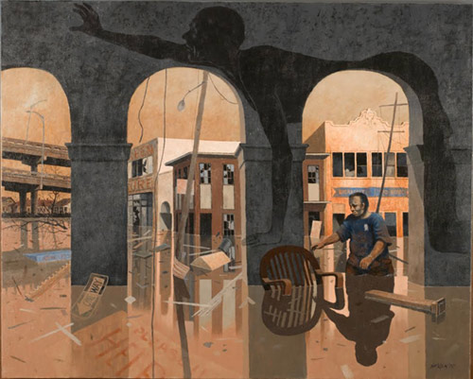
Know what is covered before trouble happens
Rolland Golden, “Arches of Misery,” 2007, acrylic on canvas, (c) The Historic New Orleans Collection 2015
Notes:
Disasters happen and are unplanned: Whether it is a natural disaster such as Hurricane Sandy or an accident such as an object piercing a canvas, objects need to be protected. Understand what is covered before trouble happens.

Slide 33
Five Essentials of Tangible Asset Management
Understand value
Follow the market
Create a strategy
Avoid pitfalls
Passion assets are emotional

Slide 34
Services
Appraiser
Insurance
Probate
Charitable Donation
Equitable Division
Gift Tax
Damage/loss
Divorce
Art Advisor
Buying & Selling
Downsizing
Speaker & Events
CE Courses
Panel Presentations
Colleen Boyle
Senior Vice President
610-470-5340
cboyle@pallmallartadvisors.com

Slide 35
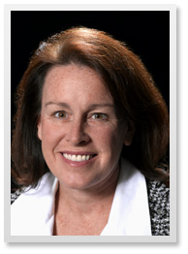
Colleen Boyle
Pall Mall Art Advisors
Senior Vice President-National Sales Director
Colleen Boyle brings over 20 years of diverse experience in the art and financial world to Pall Mall Art Advisors. She has valued art and collectibles for corporations, museums and private collectors throughout the United States. Ms. Boyle earned a Diploma in French Fine and Decorative Arts at Christie’s in Paris, a Masters degree in Art History from the University of St. Thomas and a Bachelor of Arts in Economics from The College of William & Mary. Colleen is a member of the International Society of Appraisers and is USPAP compliant. She has provided legal analysis for court cases involving art valuation and identification. Colleen regularly publishes articles in local, regional and on-line press. Ms. Boyle conducts lectures and Continuing Education classes on diverse topics pertinent to art and collectibles. She is also featured in a documentary titled ‘The Real Fake’ that will be released in 2017.
cboyle@pallmallartadvisors.com
610-470-5340

