Slide 1
Estate Planning for the Rest of Us (For Estates Under $10 Million)
Presented To:
Mercer County EPC
May 3, 2017
Presented by:
Jordon Rosen, CPA, MST, AEP®
Director – Estate & Trust Section
jrosen@belfint.com/302.573.3911
Copyright © 2016 Belfint, Lyons & Shuman, P.A.

Slide 2
About Jordon . . .
Jordon N. Rosen, CPA, MST, AEP® is a Director and shareholder in the Wilmington, Delaware CPA firm of Belfint, Lyons & Shuman, where he heads the firm’s estate and trust practice. Jordon also provides tax consulting and compliance services to the firm’s higher net worth clients and business owners. He is the Past President of the National Association of Estate Planners and Councils (NAEPC) and has served as president of the Delaware Estate Planning Council and the Chester County, PA Estate Planning Council. Mr. Rosen is also a member and past chair of the Delaware State Chamber of Commerce tax committee, is a member of the AICPA Trust, Estate and Gift Tax Technical Resource Panel, and is a member of the editorial board of Thomson Reuters Focus publication.
Jordon is a licensed CPA in Delaware and Pennsylvania and is a member of the Pennsylvania Institute of CPAs, Delaware Society of CPAs and the AICPA Tax Section. He also holds the designation of Accredited Estate Planner ® and has been recognized as a 5-Star Wealth Manager by Philadelphia Magazine and Delaware Today.
Mr. Rosen is a frequently sought out speaker both locally and nationally on tax planning and related issues and has published more than 100 articles. He has been a frequent television and radio guest and a past host of Money Talk on 1450-WILM. He received his undergraduate degree in Accounting from Temple University and his Master’s degree in Taxation from Widener University.
Copyright © 2016 Belfint, Lyons & Shuman, P.A.

Slide 3
Taxpayers Are Re-Thinking the Need for Planning
Fewer are subject to the Federal Estate Tax since the exemption is so high
Many states (i.e. Delaware) follow the Federal rules, thus eliminating any state death tax
However . . .
Non-taxable estates today may become taxable in the future
Assets grow (naturally or by inheritance)
Laws change
Some people actually win the lottery
As time passes and life events occur, most estate plans become hopelessly out of date
Copyright © 2016 Belfint, Lyons & Shuman, P.A.

Slide 4
Excuses We Hear Why Clients Don’t Think They
Need To Plan:
If there are no taxes due, what is the need for planning?
I’m too young
All of my property is jointly held with my spouse
Estate planning is only for the rich folks
It’s too expensive
We had our wills drawn up when we were married (probably more than 15 or 20 years ago!)
I don’t want to think about it
Copyright © 2016 Belfint, Lyons & Shuman, P.A.

Slide 5
Reasons Why Estate Planning is Critical for the
Modest Estate Owner
Several States (i.e. MD and NJ) have estate exclusions well below the Federal level
Several states (i.e. PA) impose a state inheritance tax
Need to provide for surviving spouse
Special needs family member
Care for minor children
Second (or third, or fourth) marriage
Asset protection (predators and spend thrifts)
Divorce planning
Copyright © 2016 Belfint, Lyons & Shuman, P.A.

Slide 6
Reasons Why Estate Planning is Critical for the
Modest Estate Owner – Continued
Closely held business/farming operations
Provide for future education needs
Charitable intent
Family dynamics (potential divorce, drug addiction)
Valuation issues
Disposition of tangible personal property
Dictate how YOU want to dispose of your estate
Planning for pets
Copyright © 2016 Belfint, Lyons & Shuman, P.A.

Slide 7
Conventional Planning Prior to 2011
Tried to equalize estates
Didn’t always know who would die first
Some assets could not be re-titled
Re-titling in separate names could create creditor issues
Each spouse created identical wills/trusts
Creating a credit-shelter trust
Creating a marital trust
Copyright © 2016 Belfint, Lyons & Shuman, P.A.

Slide 8
Conventional Planning Prior to 2011
At W’s death
Funded up to exclusion limit
CST
Children or grandchildren or trust
Income
HEMS
Estate of H
or
W
Marital Trusts
Copyright © 2016 Belfint, Lyons & Shuman, P.A.

Slide 9
Conventional Planning Challenges
Not planning at all and wasting the first-to-die’s estate exclusion
Not being able to fully fund (balance) each spouse’s CST at the first death
Not requiring that the CST be funded or leaving the decision to the surviving spouse
Copyright © 2016 Belfint, Lyons & Shuman, P.A.

Slide 10
With no Planning -Wasting the Estate Tax
Exclusion Amount
 |  | H |  | W
Total Estate |  | $5,000,000 |  | $5,000,000
Marital Deduction at H’s Death |  | (5,000,000) |  | 5,000,000
H’s Taxable Estate |  | $-0- |  | 10,000,000
W’s Estate Exclusion at W’s Death |  |  |  | (5,000,000)
W’s Taxable Estate |  |  |  | $5,000,000
Copyright © 2016 Belfint, Lyons & Shuman, P.A.

Slide 11
IRC Section 2010(c)(4)
Deceased Spousal Unused Exclusion (DSUE) amount
TRA 2010 – for decedents dying on or after 1/1/2011
Estate and gift tax exclusions were reunited at the hip (“use it now” or “use it later”)
“Portability” became permanent with the 2012 Tax Act
Final regulation became effective on June 12, 2015
Copyright © 2016 Belfint, Lyons & Shuman, P.A.

Slide 12
Applicable Exclusion Amount
(Form 706, Line 9a) |  | Basic Exclusion Amount* ($5,450,000 in 2016)
(Form 706, Line 9b) | + | DSUE**
(Form 706, Line 9c) |  | AEA
* $5,000,000 in 2011 and indexed for inflation
** Not indexed for inflation – it is frozen at date of death
Copyright © 2016 Belfint, Lyons & Shuman, P.A.

Slide 13
DSUE = Lesser of
The basic exclusion amount, or
The excess of
The applicable exclusion amount of the last such deceased spouse of such surviving spouse, over
The amount with respect to which the tentative tax is determined under Section 2001(b)(1) on the estate of such deceased spouse
IRC Section 2010 (c)(4)
Copyright © 2016 Belfint, Lyons & Shuman, P.A.

Slide 14
 |  | H |  | W
Total Estate |  | $5,000,000 |  | $5,000,000
H’s prior taxable gifts and bequest to good friend Jordon Rosen |  | (3,000,000)
 |  | 2,000,000
Bequest to surviving spouse |  | (2,000,000)
H’s taxable estate |  | $ -0-
“Ported” to surviving spouse |  |  |  | 2,000,000
Surviving spouse’s BEA |  |  |  | $7,000,000*
*Available for future gifts/bequests
Copyright © 2016 Belfint, Lyons & Shuman, P.A.

Slide 15
Generation Skipping Transfer Tax (GSTT)
No provision in law to “port” unused GST exemption
Copyright © 2016 Belfint, Lyons & Shuman, P.A.

Slide 16
Making the Portability Election
Not an affirmative election. A deemed election is made if a timely and complete 706 is filed with DSUE and there is a surviving spouse
Election is made by the executor (Form 706, Part 6)
Not available to a non-resident surviving spouse who is not a U.S. citizen, except to the extent allowable by treaty with his or her country
Assets transferred to a QDOT – calculation is preliminary (Form 706, Part 6, Section B)
Copyright © 2016 Belfint, Lyons & Shuman, P.A.

Slide 17
Making the Portability Election – Continued
Election is effective as of date of death
Election is irrevocable as of the due date of Form 706
Uncertainty of exact amount of DSUE when filing the estate tax return where the election is (deemed) made, does not negate the election; only the amount of the DSUE will change.
SOL is extended with regard to the determination of the DSUE amount until the expiration of the SOL of the surviving spouse’s estate.
Copyright © 2016 Belfint, Lyons & Shuman, P.A.

Slide 18
Requirements of Return When Making Election
Complete and properly prepared in accordance with instructions and regulations
Reporting values on Form 706 that is not otherwise required to be filed
Property subject to marital or charitable deduction– only need to report
Description
Ownership
Beneficiary
Information to establish right of estate to the deduction
Copyright © 2016 Belfint, Lyons & Shuman, P.A.

Slide 19
Requirements of Return When Making Election – Continued
Rule does not apply to property if
Value needed to determine value passing to another recipient
Value needed to determine eligibility under Section 2032 (alternate valuation), 2032A (farm valuation), or Section 6166 (extension of time to pay tax)
Less than the entire interest in the property is marital or charitable deduction property
A partial disclaimer or partial QTIP election is made with respect to property which is marital or charitable deduction property
Copyright © 2016 Belfint, Lyons & Shuman, P.A.

Slide 20
Statement Required on Form 706
If executor exercises due diligence to estimate FMV of the gross estate
Executor (under current regulations) can include his/her best estimate rounded to the nearest $250,000
Signed under penalties of perjury
Will be considered a complete and properly filed return
Regulation Section 20.2010-2T(a)(7)
Copyright © 2016 Belfint, Lyons & Shuman, P.A.

Slide 21
Who is Permitted to Make (or opt-out-of) the Election?
Duly appointed executor or administrator of the estate
If no duly appointed executor – a non-duly appointed executor in actual or constructive possession of any property of the decedent
Portability election made by a non-appointed executor cannot be superseded by a contrary election by another non-appointed executor of the same estate
What if executor and surviving spouse do not agree?
Copyright © 2016 Belfint, Lyons & Shuman, P.A.

Slide 22
Late Elections
No relief if estate was otherwise required to file Form 706
If filing just to elect portability
Section 9100 relief may be available.
Treasury hesitating to make this relief permanent for fear of executors not making the election until after the surviving spouse’s death
Copyright © 2016 Belfint, Lyons & Shuman, P.A.

Slide 23
Opting Out of Portability
✓ the box – Form 706, Part 6, Section A
Small estates that otherwise do not have to file Form 706, simply do not file anything
If a return is otherwise required to be filed, the filing of a late Form 706 is considered opting-out of the portability election (Prop. Reg. Section 20.2010-2(a)(3)(ii))
Hazards of not electing portability
Assets grow
Some people actually win the lottery
Copyright © 2016 Belfint, Lyons & Shuman, P.A.

Slide 24
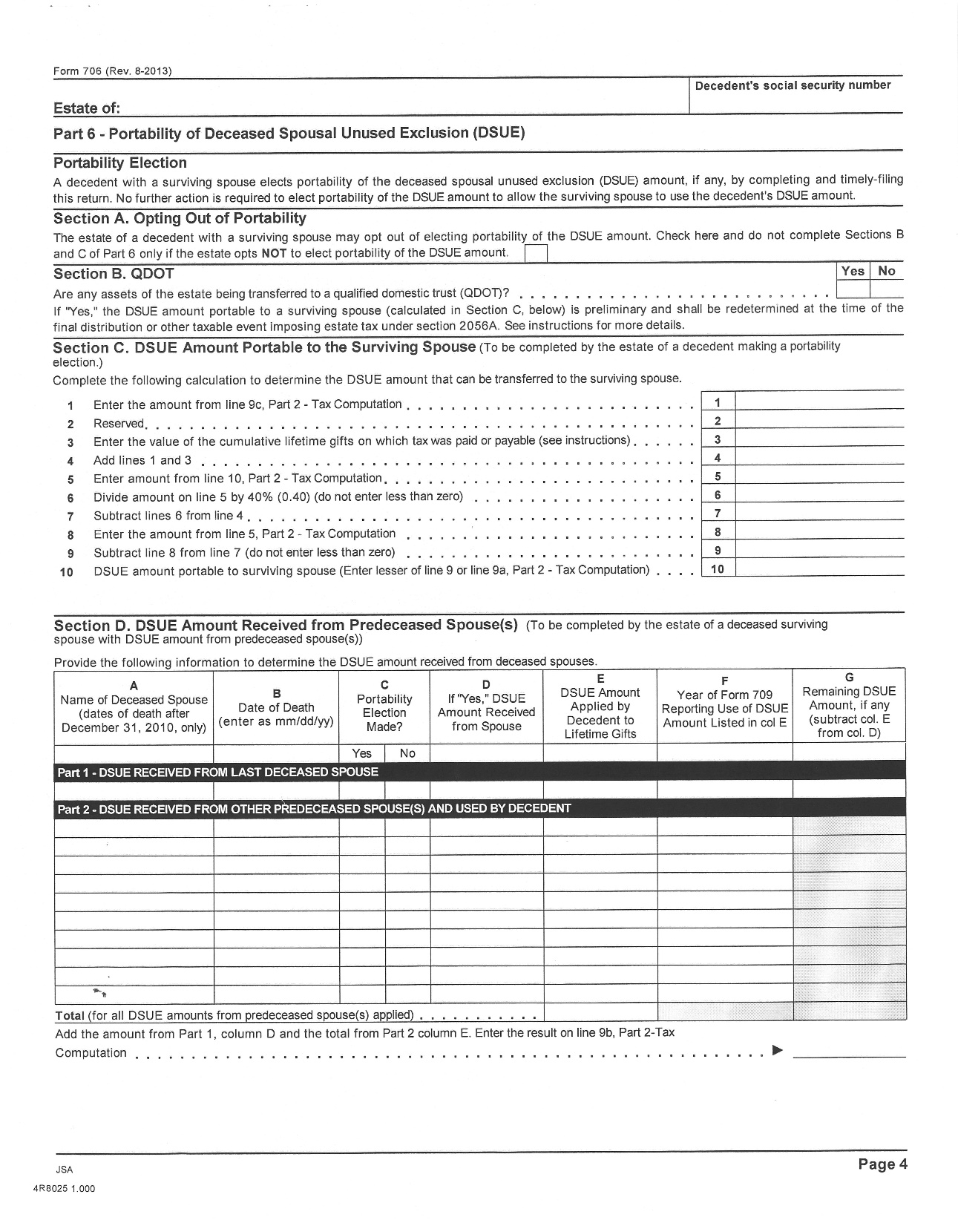
Copyright © 2016 Belfint, Lyons & Shuman, P.A.

Slide 25
Last Deceased Spouse
Most recently deceased person who was married to the surviving spouse at the time of that person’s death
Identity as of day of taxable gift or the date of the surviving spouse’s death
Re-marriage does not alter the designation of last deceased spouse. Surviving spouse can apply DSUE amount to future lifetime gifts
Apply DSUE first; then own BEA
Multiple DSUE amounts
Copyright © 2016 Belfint, Lyons & Shuman, P.A.

Slide 26
How Smaller Estates Will Be Affected By
Basis Consistency Rules
New Form 8971 Reporting Rules
Copyright © 2016 Belfint, Lyons & Shuman, P.A.

Slide 27
DSUE v. CST
or
Income Tax v. Estate Tax
Copyright © 2016 Belfint, Lyons & Shuman, P.A.

Slide 28
Estate Tax vs. Income Tax Planning
Highest Estate Tax Rate is 40%
Highest Marginal Personal rate is 39.6%
New 3.8% surtax
State income tax
Since most taxpayers will not be subject to the estate tax, more focus needs to be on the income tax aspects
Planning on an asset-by-asset basis
“BASIS” planning is the new normal
Best assets to have in your estate (i.e. Roth IRA, tax-exempt bonds)
Worse assets to have in your estate (i.e. traditional IRA)
Need to consider the tax implications to the beneficiaries
May drive which assets to spend down first
Copyright © 2016 Belfint, Lyons & Shuman, P.A.

Slide 29
Providing for Surviving Spouse
Use of trust
To provide income annually for life
To provide principal distributions for health, maintenance, support and welfare
To protect assets from creditors and future spouses
Prior wills/trusts may provide that “credit-shelter” trust be funded up to the estate tax exclusion amount
Unintended consequences
Should re-visit provisions
Will not provide a second basis step-up as opposed to electing portability
QTIP – discussed later in outline
Copyright © 2016 Belfint, Lyons & Shuman, P.A.

Slide 30
Advantages of CST
Asset protection (generally not available using DSUE)
Appreciation exempt from surviving spouse’s estate (but no step-up)
GST protection
Copyright © 2016 Belfint, Lyons & Shuman, P.A.

Slide 31
Advantages of DSUE Election
Get a second basis step-up at surviving spouse’s death
Ultimate Federal and state capital gains tax savings
Lower administrative expenses
Allows for spousal rollover of IRA/retirement plan assets
Allows for stretch IRA for non-spousal beneficiaries
Control/GPA (limited for retirement plan assets)
Income subject to individual tax brackets, not condensed trust brackets
Could save/avoid NII tax for same reason
Copyright © 2016 Belfint, Lyons & Shuman, P.A.

Slide 32
Using a QTIP Trust
No estate tax inclusion at first death
Included in surviving spouse’s taxable estate
Assets get a second step-up
Control-keeps assets in family
General asset protection
Can get GST protection with a reverse QTIP election
T.D. 9725 – Treasury and IRS intend to provide guidance . . .
Whether a QTIP election made under Section 2056(b)(7) may be disregarded and treated as null and void when an executor has elected portability of the DSUE amount under Section 2010(c)(5)(A). Also, see Rev. Proc. 2001-38.
Copyright © 2016 Belfint, Lyons & Shuman, P.A.

Slide 33
Community Property
Each spouse owns half the property
DSUE is not as much of an issue
Copyright © 2016 Belfint, Lyons & Shuman, P.A.

Slide 34
State Death Taxes
DSUE (portability) is a federal concept
States have not yet adopted portability election statutes
May need to be creative in states where estate exclusion is less than the Federal amount
NJ - $675,000
MD - $1,500,000 in 2015 (will match federal amount by 2019)
PA - $0
Use of CST to protect assets up to state exclusion
Use of Marital Trust followed by gift to children’s trust by surviving spouse (could have limited benefits in states such as CT and PA)
Copyright © 2016 Belfint, Lyons & Shuman, P.A.

Slide 35
Qualified Domestic Trust (QDOT)
Allows for marital deduction for bequeathed property passing to a surviving spouse who is not a U.S. Citizen
Estate tax is generally imposed under Section 2056A when distributions are made from the trust
If DSUE amount
Executor determines a preliminary DSUE amount
Decreases as Section 2056A distributions are made
Not available to the surviving spouse against tax on lifetime gifts since final determination of DSUE is postponed until death of surviving spouse or termination of QDOT
Copyright © 2016 Belfint, Lyons & Shuman, P.A.

Slide 36
Post-Mortem Elections
Portability
Reduces need to “equalize” estates
May need to revisit older documents
Use of credit shelter trust for clients living in states that do not recognize portability or have a lower estate exemption
Must file Form 706 (Estate Tax Return) to elect portability, even if no return is otherwise needed
Must be on a timely filed return
DSUE amount not indexed for inflation
Provides a second basis step-up opportunity
EE/E Bonds
Can elect to report accrued but unreported bond interest through date of death on final 1040
Future interest reported by beneficiaries
Copyright © 2016 Belfint, Lyons & Shuman, P.A.

Slide 37
Post-Mortem Elections – Continued
QTIP election – for the second family
Provides income for second spouse for life
Remainder goes to children from first marriage
Value of trusts includable in second spouse’s estate
Fiscal Year of Estate
Calendar
Fiscal - no later than last day of month preceding month of death
Copyright © 2016 Belfint, Lyons & Shuman, P.A.

Slide 38
Post-Mortem Elections – Continued
Section 645 election
Allows calendar year revocable trust to file as part of estate’s fiscal year
Can defer income
Saves administrative fees
Limited life
Made with timely filed return
Disclaimers
GSTT
Copyright © 2016 Belfint, Lyons & Shuman, P.A.

Slide 39
Annual Gifts
$14,000 per donee in 2016
Lifetime exclusion now linked to estate exclusion ($5.45 million in 2016)
Direct payment of medical and education expenses to provider avoids ALL gift tax implications
Making gifts in excess of annual exclusion amount may still have benefits
State issues in PA –
Inheritance tax is still an issue
Gifts within 1 year of death are pulled back into estate
Consider the non-tax reasons for making gifts
Copyright © 2016 Belfint, Lyons & Shuman, P.A.

Slide 40
Income Tax Considerations for Making Annual Gifts of Appreciated Property
Carryover basis of gift vs. basis step-up at death will be a case-by-case consideration
Donee gets donor’s cost basis and holding period associated with gifted property
Sale by donee will generally produce capital gain, taxed at 0% 15%, 20%
Be mindful of Section 1411 Surtax of 3.8%
Donee could be hit with recapture
Taxed at 25% (Unrecaptured Sec. 1250)
Ordinary tax rates
Copyright © 2016 Belfint, Lyons & Shuman, P.A.

Slide 41
Valvation Issues
Discounts
Full basis step-up at death may be a better deal if estate is not taxable
Reconsider prior planning
It’s all about basis planning and income taxes for smaller estates
Use of FLPs
Use of QPRTs
Copyright © 2016 Belfint, Lyons & Shuman, P.A.

Slide 42
Basic Documents and Issues
Wills
Maybe a pour-over will is appropriate
Names executor and successors
Generally addresses payment of final expenses, funeral expenses and disposition of TPP
Revocable Trust
A “will replacement” for assets titled to the trust
Critical to also name successor trustees
Provides privacy
Can provide separate disposition instructions for a different class of beneficiaries than in the will
In Delaware – avoids 1.75% probate fee
Copyright © 2016 Belfint, Lyons & Shuman, P.A.

Slide 43
Basic Documents and Issues – Continued
Advance Medical Directives
Durable Power of Attorney
Name of power holder and possible successors
Be careful who you name as power holder
Immediate or upon happening of an event
Generally preferable to adding a name onto an account
Copyright © 2016 Belfint, Lyons & Shuman, P.A.

Slide 44
Beneficiary Designations
Applicable to
IRAs, Roth IRAs
Employer plans
Life Insurance
Annuities
Bank and brokerage accounts
Review and update as needed
Birth
Death
Divorce
Marriage
Other
Copyright © 2016 Belfint, Lyons & Shuman, P.A.

Slide 45
Beneficiary Designations - Continued
Consider providing copies to advisors
“Per stirpes”
Trusts as beneficiary
Charity as beneficiary
Separation of accounts
Percentage of account balance
Best assets to leave to a charity
Copyright © 2016 Belfint, Lyons & Shuman, P.A.

Slide 46
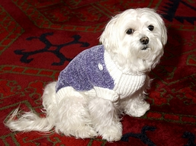
Estate Planning for Pets
Use of trusts
Who pays the Income tax?
Does Rover and Fluffy need ID numbers?
Who is the trustee?
Who cares for Fido?
Leona Helmsley left $12 million to her dog, Trouble.
(court eventually reduced the inheritance to $2 million)
Security - $100,000/yr.
Grooming - $8,000/yr.
Food – $1,200/yr. (went from crab cakes to Alpo)
Medical - $2,500-$18,000/yr.
Guardian fee - $60,000/yr.
Copyright © 2016 Belfint, Lyons & Shuman, P.A.

Slide 47
Questions
Jordon Rosen, CPA, MST, AEP®
Director – Estate & Trust Section
jrosen@belfint.com/302.573.3911
Copyright © 2016 Belfint, Lyons & Shuman, P.A.

